Slide 1


Full Stack Self-Service Diagnostics with Dynatrace
Wayne Segar
Senior Architect
Matt Miller
Solution Architect
Chris Schwarzbauer
Lead Product Architect

Slide 2
Prerequisites
Personal AWS Account:
https://aws.amazon.com/free/
Postman API Client
https://www.getpostman.com/downloads/
Download/Clone the Repository:
https://github.com/wmsegar/Dynatrace-Hotday-2019-SelfServiceDiagnostics
or
https://bit.ly/2MkMkgI

Slide 3
Agenda
Formalities
Introductions
What we’re covering
Level of Expertise required
Individual EC2 Instances
EasyTravel – Book Exciting travel to far away destinations
Setup and Launching our EC2 instance with EasyTravel
Configuration API
Use Case 1 – CPU Increase
Use Case 2 – Booking Failure
Use Case 3 – Slow Login
Use Case 4 – Homepage Slowdown
Tips and Tricks

Slide 4
What we’re covering/not covering
This is an exploration of common
This is not a product tutorial
This is not a test
There is no need to be an AWS expert and everything we are covering can be applied to ANY environment (e.g. Azure, GCP, Kubernetes, On-Prem, etc…)
The goal of this sessions is:
Help you become more comfortable using Dynatrace to diagnose application problems
Make the diagnosis easy for others in your organization
Not everybody needs to be a “Dynatrace Expert”

Slide 5
How we’re covering
We will walk through several Use Case Problem patterns
Each Student will have their own private EC2 instance running a version of EasyTravel (created via CloudFormation)
Each Student will have their own private Dynatrace SaaS tenant
Tenant ID and Credentials on your attached card
During the course of this session we will be doing the following:
Creating our environment via CloudFormation
Performing Dynatrace configurations via the UI and the API
Triggering EasyTravel Problem Patterns via the EasyTravel Config UI

Slide 6
Level of Expertise
Basic Dynatrace familiarity
Expert certification not required
REST API basics

Slide 7
Setup Work

Slide 8
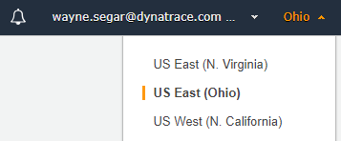
Setup AWS: Default Region
Login to your AWS Account: https://aws.amazon.com
Validate and make note of your default region

Slide 9
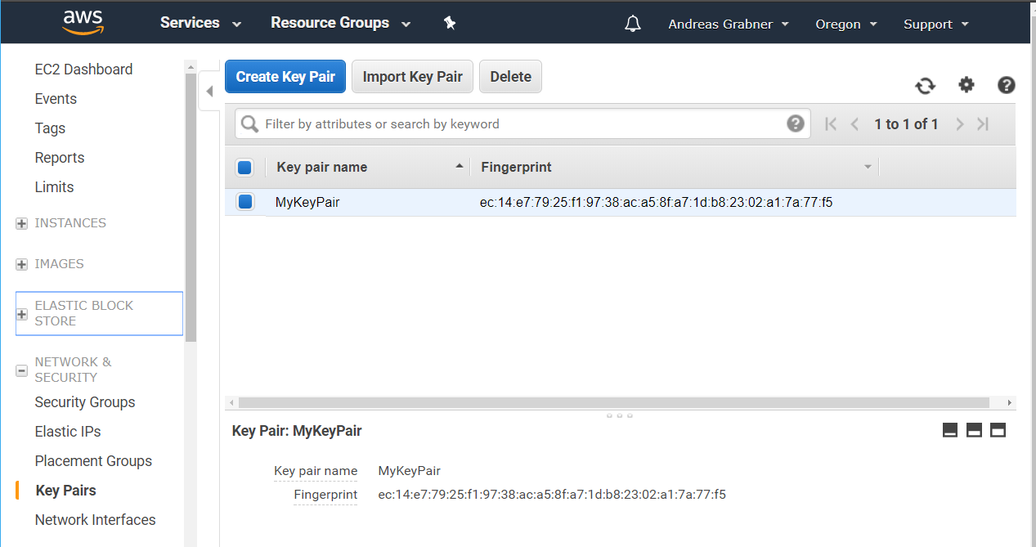
Setup AWS: EC2 Key Pair
Create EC2 Key Pair
Go to EC2 – Pick Region
Click on Key Pairs
Create a new Pair
Store the .pem file

Slide 10
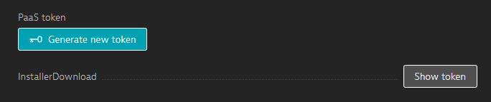
Setup Dynatrace: Retrieve API Token
Login to your Dynatrace SaaS Tenant provided to you:
https://<TENANT_ID>.sprint.dynatracelabs.com
Navigate to:
Click “Deploy Dynatrace” from the left side menu
Click “Start Installation”
Click “Set up PaaS monitoring”
Click “Show token”
Copy your token to your clipboard

Slide 11
Launching our EC2 Instance
Our CloudFormation Template will create a Production Linux server with EasyTravel installed/running and deploy a OneAgent pointing to your Dynatrace SaaS Tenant

Slide 12
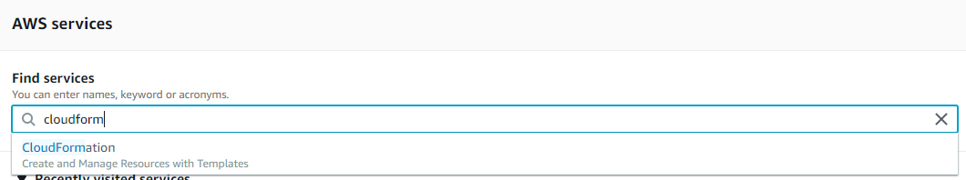
Launching the CloudFormation Stack
Launching the Stack
Upload Template
Filling in the Details
Create and Confirm
Follow Events
View Outputs
Validate Environment
Cleanup
What is CloudFormation?
A declarative way to define AWS Resources, e.g: EC2, CodeDeploy, CodePipeline, Lambda, Roles, ELBs, …
Learn more about CloudFormation: https://docs.aws.amazon.com/AWSCloudFormation/latest/UserGuide
Our Steps
In your AWS Console browse to the CloudFormation Service

Slide 13
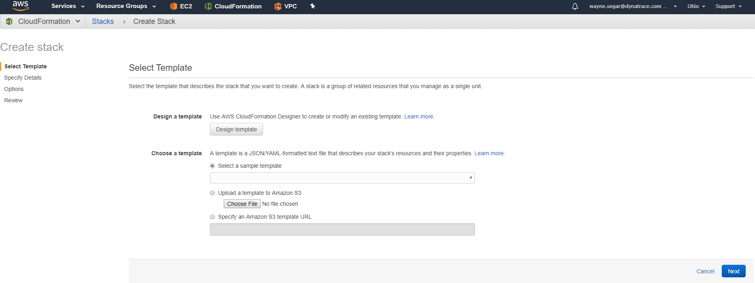
Upload Template
Launching the Stack
Upload Template
Filling in the Details
Create and Confirm
Follow Events
View Outputs
Validate Environment
Cleanup
Your selected region
Upload the file Hotday2019FullStackDiagnosticsCloudformationScript.json
CloudFormation can be found in the GitHub repository

Slide 14
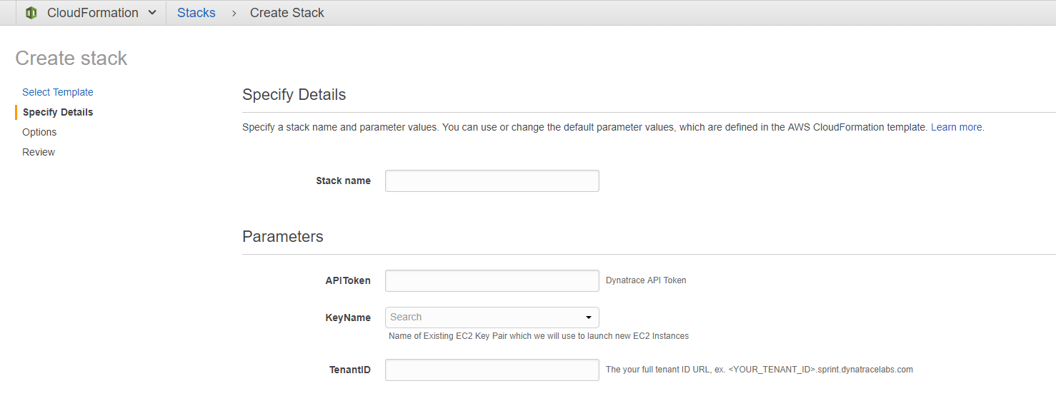
Filling in the Details
Launching the Stack
Upload Template
Filling in the Details
Create and Confirm
Follow Events
View Outputs
Validate Environment
Cleanup
Any name, e.g: dynatracehotday
Your Dynatrace API Token
Your AWS EC2 Key Pair
Your Dynatrace Tenant URL

Slide 15
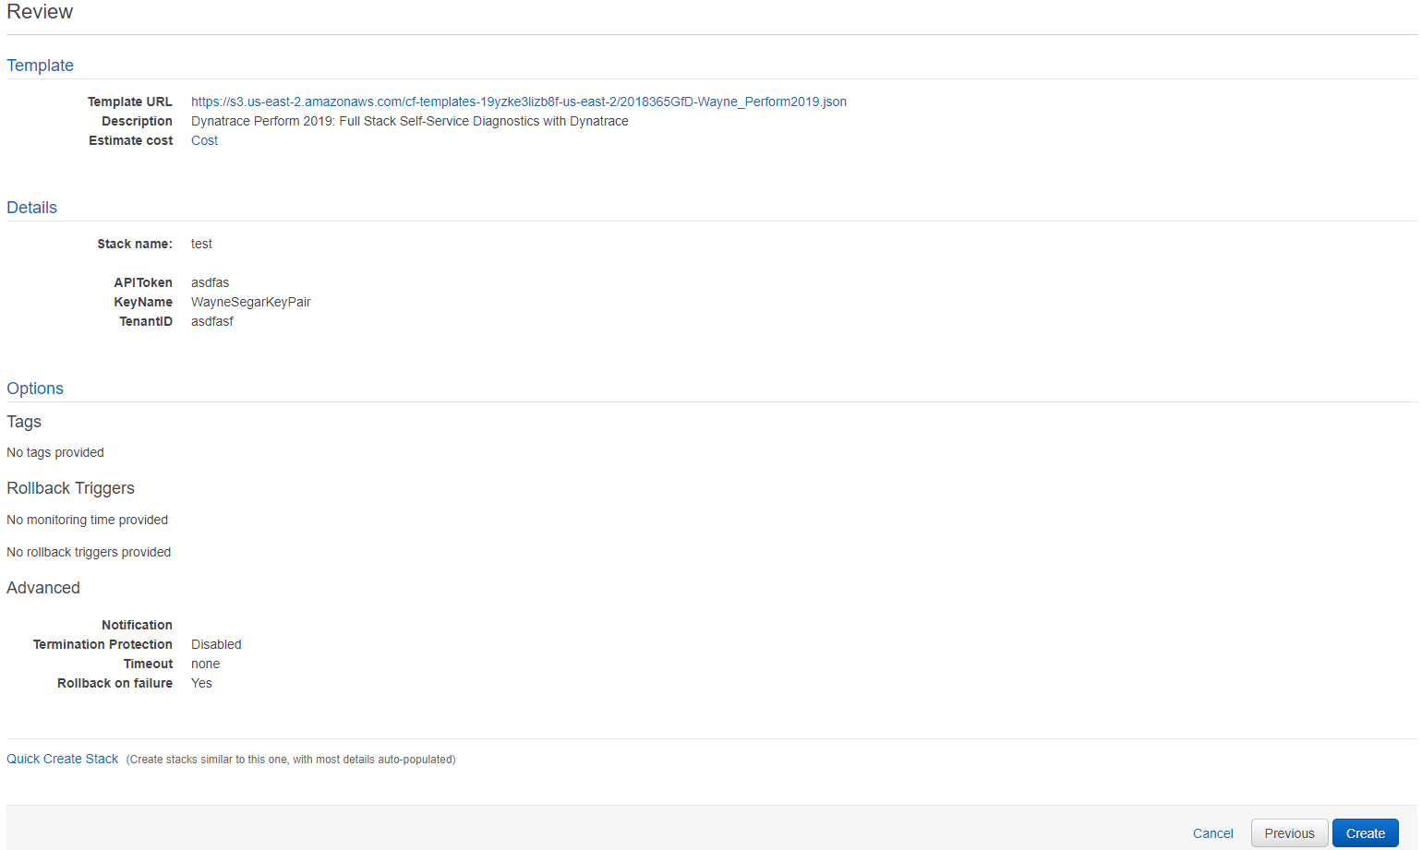
Create and Confirm
Launching the Stack
Upload Template
Filling in the Details
Create and Confirm
Follow Events
View Outputs
Validate Environment
Cleanup

Slide 16
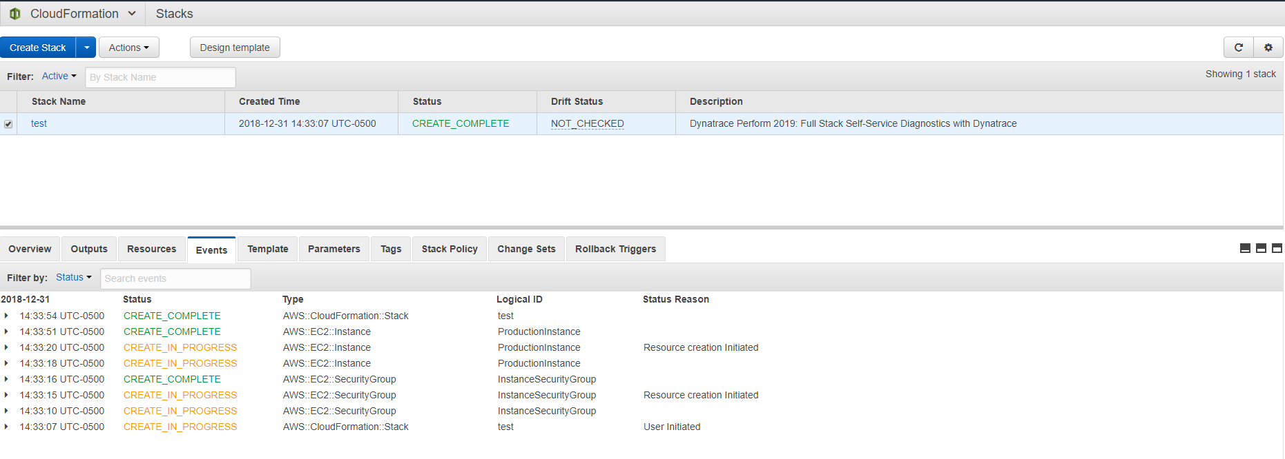
Follow Events
Launching the Stack
Upload Template
Filling in the Details
Create and Confirm
Follow Events
View Outputs
Validate Environment
Cleanup
Watch as AWS Resources get created

Slide 17
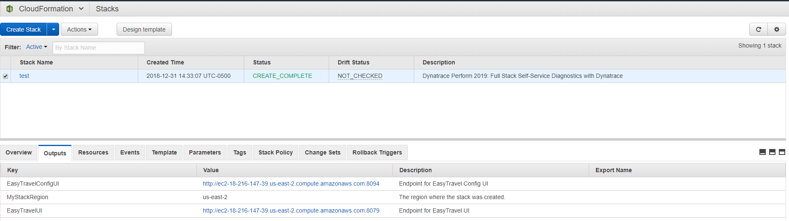
View Outputs
Launching the Stack
Upload Template
Filling in the Details
Create and Confirm
Follow Events
View Outputs
Validate Environment
Cleanup
View Output URLs
Note: It will take roughly 10 minutes for EasyTravel to fully come up

Slide 18
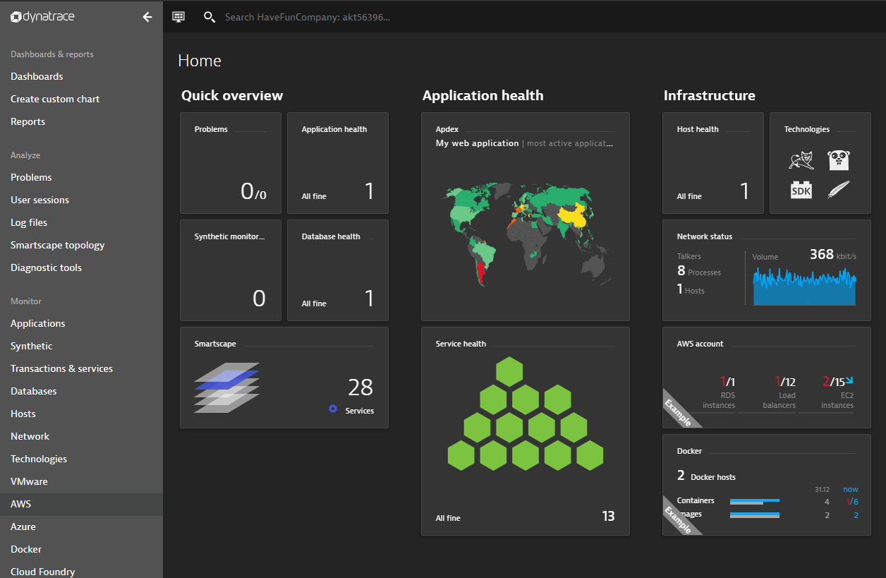
Validate Environment
Launching the Stack
Upload Template
Filling in the Details
Create and Confirm
Follow Events
View Outputs
Validate Environment
Cleanup
Host Displayed
Services Populating

Slide 19
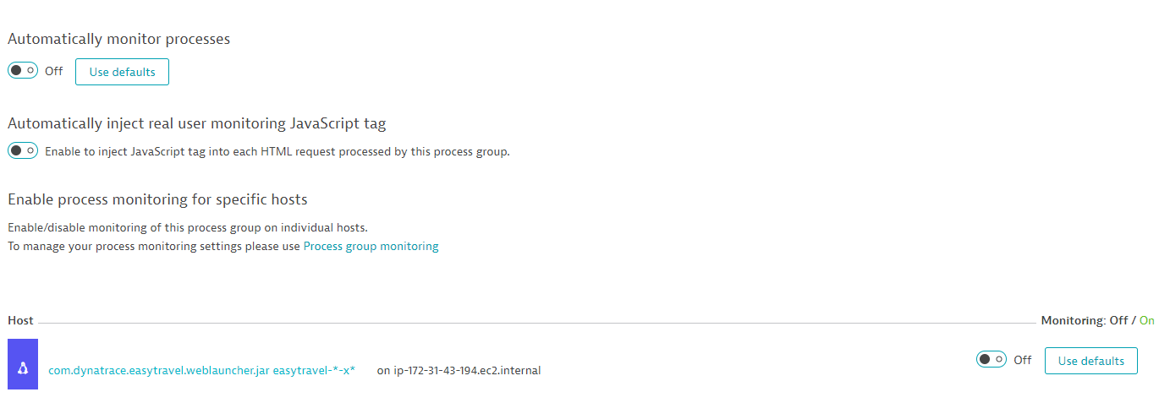
Cleanup
Launching the Stack
Upload Template
Filling in the Details
Create and Confirm
Follow Events
View Outputs
Validate Environment
Cleanup
Would it be nice if this was automated via the ConfigAPI?
Vote for RFE: https://bit.ly/2RGytHF
In order to get RUM data to stitch to backend services we need to disable deep monitoring of the Easytravel Weblauncher process. (This is specific to Easytravel)
Technologies > Select “weblauncher.jar” process group > Process group details > Edit > Disable for the host.
Set to Off
Set to Off

Slide 20
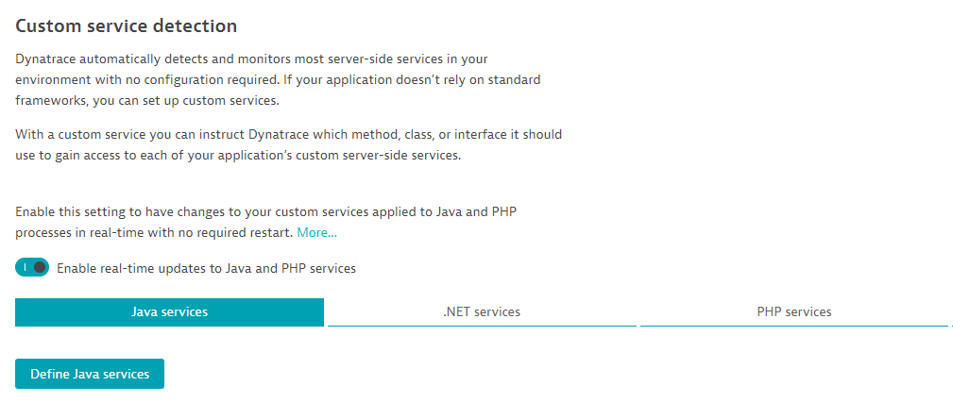
Cleanup
Launching the Stack
Upload Template
Filling in the Details
Create and Confirm
Follow Events
View Outputs
Validate Environment
Cleanup
Enable Java Hotsensor Placement
We will be creating Custom Services in the next section so we will need this in order to avoid a required restart of the Java Processes
Settings > Server-side > service monitoring > Custom service detection > Enable real-time updates to Java and PHP services
Set to Enabled

Slide 21
Things to be done in tenant
Disable service monitoring of weblauncher process
Enable Hotsensor Placement
Change User Action Naming for Default XHR actions to “User Input”

Slide 22
Configuration API

Slide 23
Dynatrace Configuration API
The Dynatrace Configuration API allows API consumers to globally read and write the configuration settings of any Dynatrace environment
The primary use cases for the Configuration API are:
Read and copy an existing environment configuration over to a new environment.
Create or change individual configuration settings via the API when setting up a new environment.
Read and store configurations, along with their histories, in a version management system (for example, Git).
Provide a mechanism to automate Monitoring/Performance-as-a-Service
Provide easy access to meaningful data to Application Owners with creation of Management Zones
Simplify complex environment with auto tagging rules
Extract specific business context information with request attributes

Slide 24
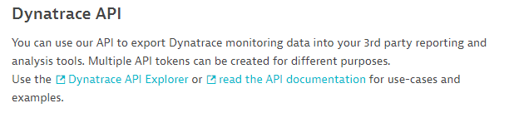
View the Configuration API Explorer
In your Dynatrace tenant navigate to:
Settings > Integration > Dynatrace API
Click “Dynatrace API Explorer”

Slide 25
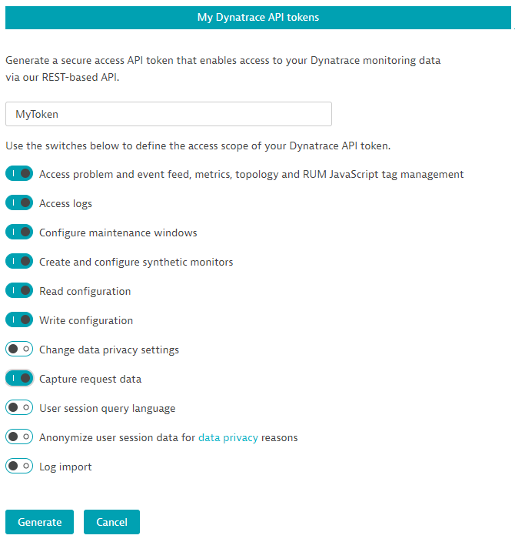
Create API Token to use the Config API
In the Dynatrace API screen, click “Generate token”
Enter a name for your token (ex. MyToken)
Make sure to enable the following switches
Click the “Generate” button

Slide 26
Using the ConfigAPI via Postman
We will be using Postman to run a series of API requests to the ConfigAPI in order to do the following:
Create Auto Tagging rules
Create Management Zones
Application setup (URL Grouping and Framework support)
Create Custom Services
Create Request Attributes
Create Synthetics Monitors
You can use any API client to interact with any of the Dynatrace APIs, however, for this course we are using Postman because it is simple to share a collection of API requests.

Slide 27
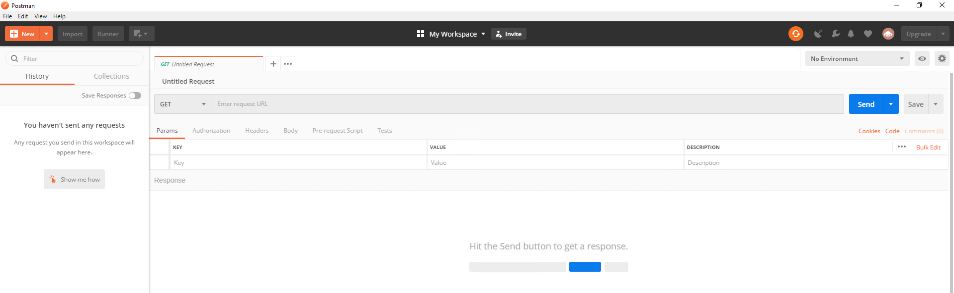
Setup Postman
If this is the first time you are using Postman, after you download and install, you will need to create a free account.
You can press “setup later”/”skip” on the Preferences and Team screens

Slide 28
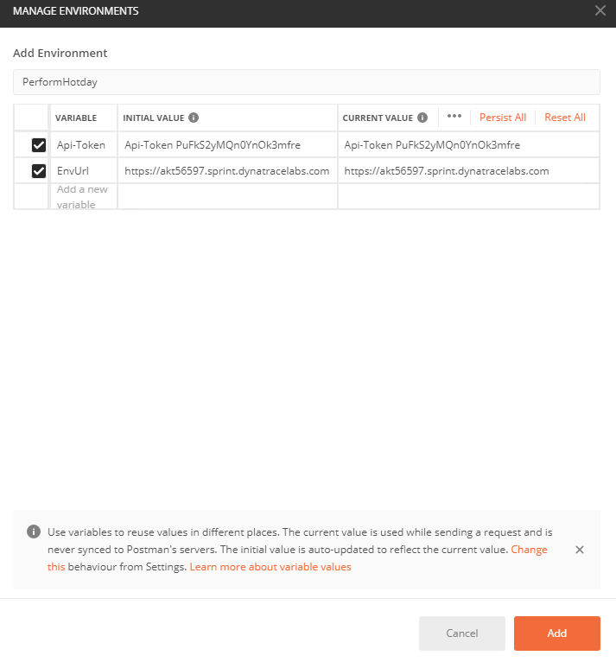
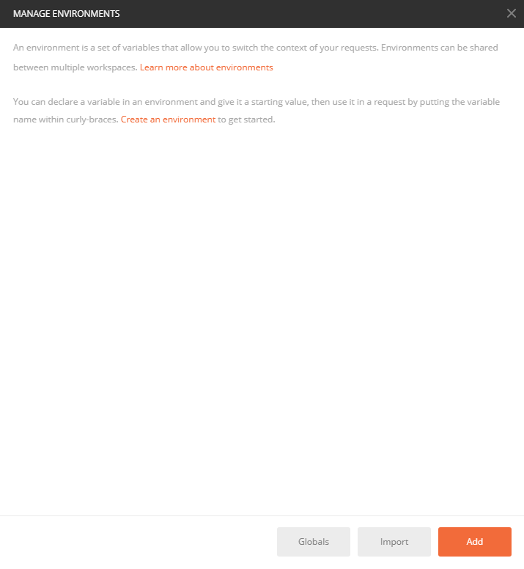

Setup Postman (cont.)
Enter a name for your Environment
Create 2 Variables EXACTLY as they appear here
Create an Environment with Variables for your Tenant and API Token
Click the icon in the upper right hand corner for the Manage Environments popup to appear
Populate the values with your Full Tenant URL and API-Token
Click “Add” to create the Variables
Create an Environment

Slide 29
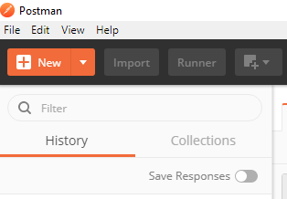
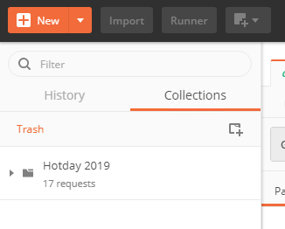
Importing the Config API Collection
Click the “Import” button in the upper left corner
In the Import dialog box, click “Choose Files”
Browse to the location where you downloaded the Github repository, and select the file: “Hotday 2019.postman_collection.json”
After the file is uploaded, select “Collections” in the upper left corner and you should now see the collect that was just imported titled “Hotday 2019”

Slide 30
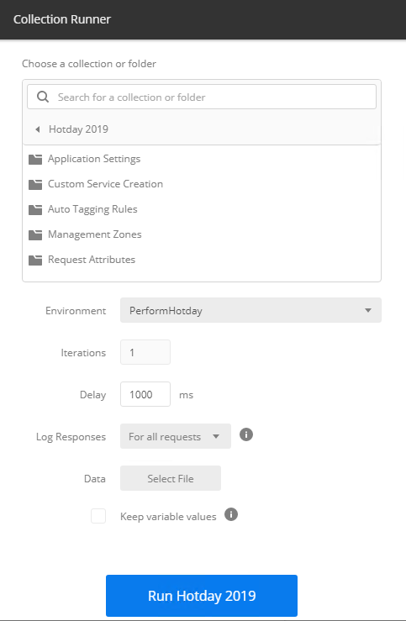
Running the API Collection
In the “Hotday 2019” collection click the \ button and Click “Run” in the popout menu
The Collection Runner should now popup:
Select the Environment you created from the dropdown
Enter 1000ms Delay
Click “Run Hotday 2019”

Slide 31
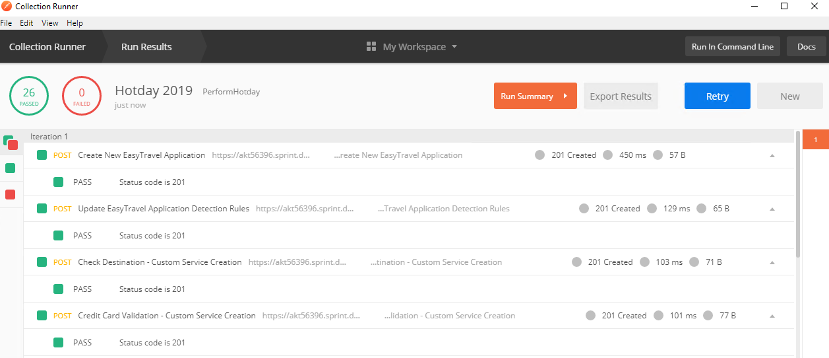
Run Validation
After running the collection, a Run Results window should popup with all requests successful

Slide 32
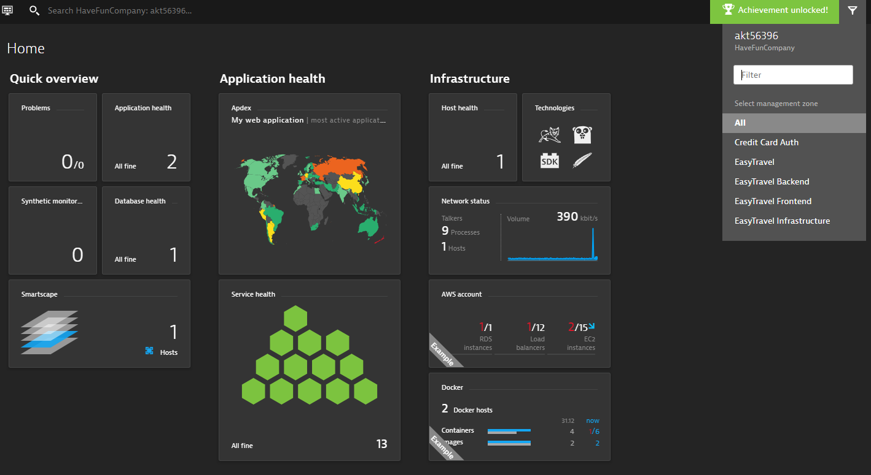
Verify the Results
Back in your Dynatrace tenant, you should now see the results of the Config API (ex. Management Zones, Tags, etc…)

Slide 33
Use Case #1 – CPU Increase
Notes:
Problem: CPULoad

Slide 34
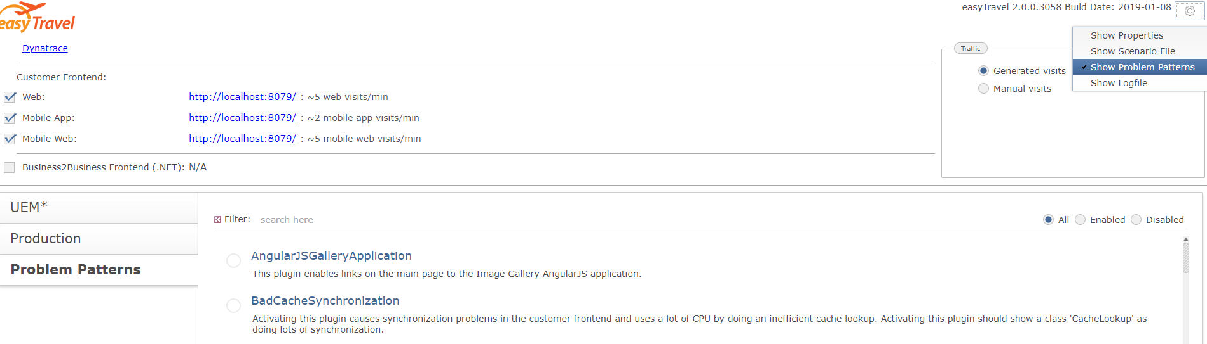
Problem Pattern #1 – CPU Increase
How to trigger Problem:
Navigate to the EasyTravelConfigUI – This URL was Output as part of the CloudFormation script
Once in the EasyTravelConfigUI, enable “Show Problem Patterns”

Slide 35
Problem Pattern #1 – CPU Increase (cont.)
How to trigger Problem:
In the Filter bar search for the Problem Pattern “CPULoad”
Click the “CPULoad” Problem Pattern to trigger the problem

Slide 36
Use Case #1 – CPU Increase
Background
EasyTravel is the main revenue generating application for booking travel. After a recent deployment to one of the backend components, your team notices that CPU usage is much higher than usual. This of course could impact users attempting to book travel on our site.
Quick Survey: https://www.surveymonkey.com/r/XJD6WLJ
Investigate and figure out why this is happening
How would you instruct the Dev team to go about finding the problem and triaging it?

Slide 37
Use Case #1 – CPU Increase (cont.)
How to investigate the problem:
Navigate to Diagnostic Tools and select the CPU Profiler (filter by Management Zone or Tag)
View the Service with the Highest CPU consumption
Navigate to the code level breakdown to determine what piece of code is causing increase in CPU consumption

Slide 38
Use Case #2 – Booking Failure
Notes:
Problem: CreditCardCheckError500

Slide 39
Problem Pattern #2 – Booking Failure
How to trigger Problem:
In the Filter bar search for the Problem Pattern “CreditCardCheckError500”
Click the “CreditCardCheckError500” Problem Pattern to trigger the problem

Slide 40
Use Case #2 – Booking Failure
Background
The Marketing Department just called in a panic that bookings dropped to near zero over the past few minutes! Obviously, this is a pretty big issue because the core business is being impacted.
Quick Survey: https://www.surveymonkey.com/r/XQ9L6RB
Investigate and figure out why this is happening
How would you instruct the Dev team to go about finding the problem and triaging it?

Slide 41
Use Case #2 – Booking Failure (cont.)
How to investigate the problem:
Navigate to Diagnostic Tools and select the Exception Analysis (filter by Management Zone or Tag)
Determine the exception message that is “most likely” the culprit
Determine which Service is causing this Exception and what should be done

Slide 42
Use Case #3 – Slow User Login
Notes:
Problem:DBSpammingAuthWithAppDeployment

Slide 43
Problem Pattern #3 – Slow User Login
How to trigger Problem:
In the Filter bar search for the Problem Pattern “DBSpammingAuthWithAppDeployment”
Click the “DBSpammingAuthWithAppDeployment” Problem Pattern to trigger the problem

Slide 44
Use Case #3 – Slow User Login
Background
After a recent deployment to a component of EasyTravel customers are beginning to call the helpdesk and complain that logging in to view/book travel is “slow”.
Quick Survey: https://www.surveymonkey.com/r/XW2T5R9
Investigate and figure out why this is happening
How would you instruct the Dev team to go about finding the problem and triaging it?

Slide 45
Use Case #3 – Slow User Login (cont.)
How to investigate the problem:
Navigate to Diagnostic Tools and Select Top Database Statements
Determine if there are any slow running queries are impacts from the recent change
Determine what Service is responsible for this
Is this a Database Slowdown issue?

Slide 46
Use Case #4 – Homepage Slowdown
Notes:
Problem: JourneyUpdateSlow

Slide 47
Problem Pattern #4 – Homepage Slowdown
How to trigger Problem:
In the Filter bar search for the Problem Pattern “JourneyUpdateSlow”
Click the “JourneyUpdateSlow” Problem Pattern to trigger the problem

Slide 48
Use Case #4 – Homepage Slowdown
Background
The Operations team is claiming that the ‘Special-Offers.jsp’ and ‘CalculateRecommendations’ pages are experiencing a significant increased response time. VP of Operations is not happy. Your job is to find out what’s going on with these pages. Some other pages may also be affected.
Quick Survey: https://www.surveymonkey.com/r/XSJVJ3P
Investigate and figure out why this is happening
How would you instruct the Dev team to go about finding the problem and triaging it?

Slide 49
Use Case #4 – Homepage Slowdown (cont.)
How to investigate the problem:
In Diagnostic Tools, view the Top Web Requests and search for Special-Offers.jsp and CalculateRecommendations Web Requests
View the Service Flow and look for the highest % of contribution
Determine if this is a Database issue or an Application issue or both

Slide 50
Tips & Tricks

Slide 51
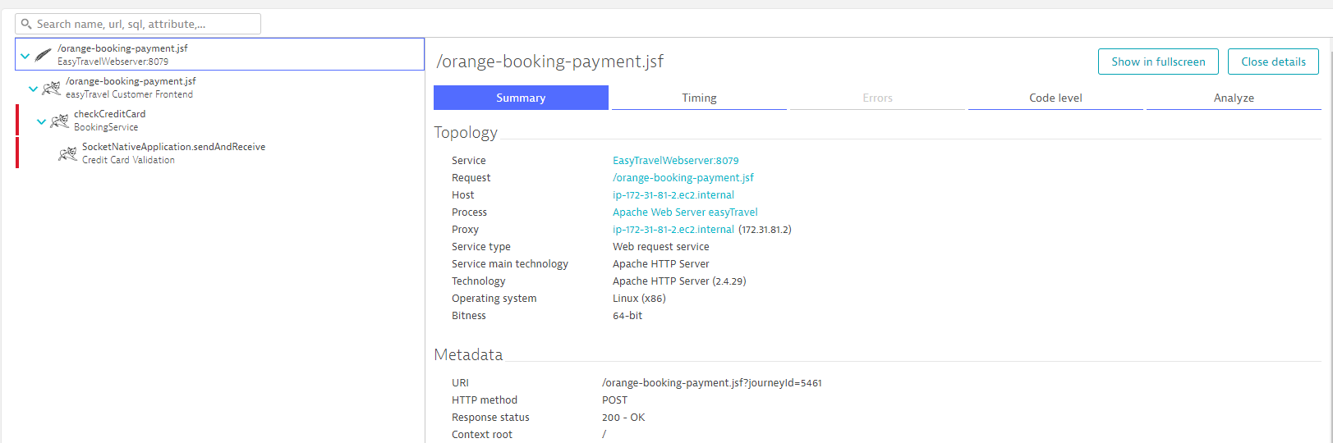
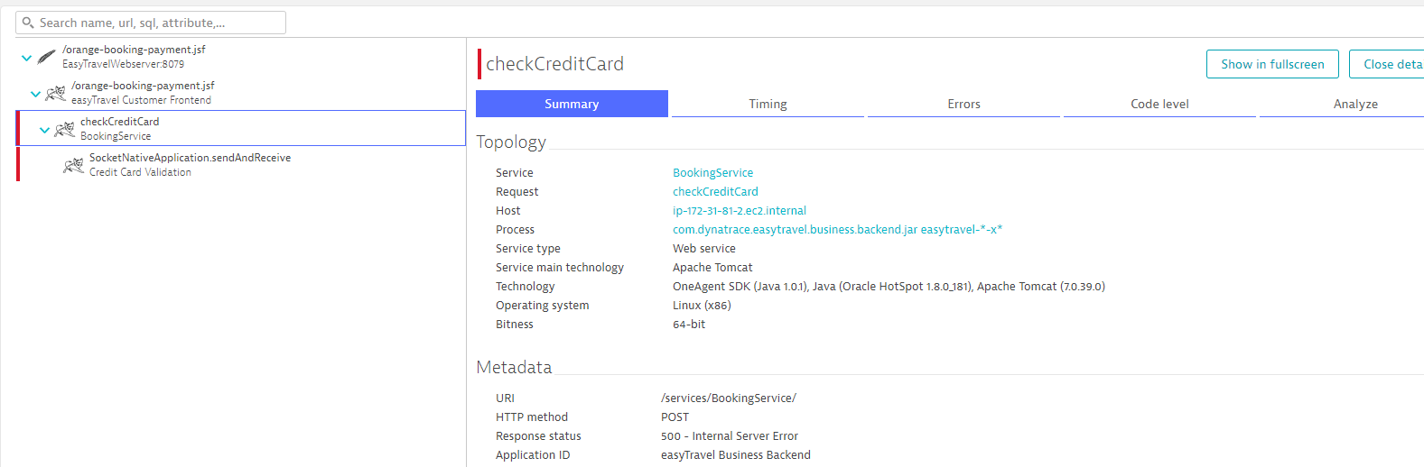
Returning HTTP 200 on Failure
Try to avoid returning a HTTP 200 to the user, when the transaction actually fails:
Service Call fails with 500
HTTP 200 Returned to user

Slide 52
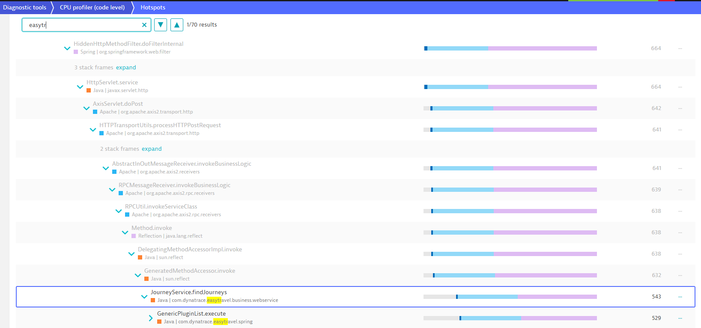
Finding your code in the CPU Profiler
The CPU Profiler shows the full Stacktrace samples for the Service, which includes many “internal” packages (java.lang, org.apache, System.net, etc…)
Using the Search box to search for your Packages is extremely useful

Slide 53
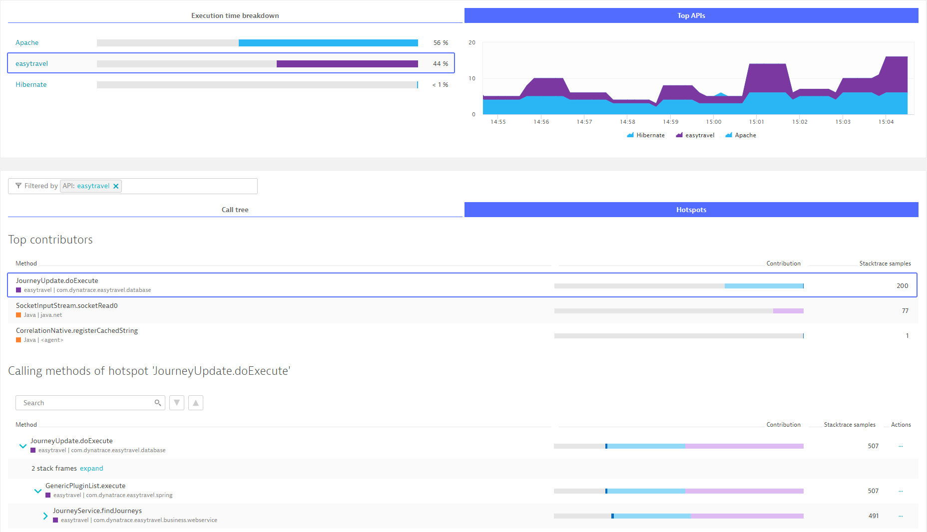
Finding your code in the CPU Profiler (cont.)
Filtering by API is also useful
Customize API Detection Rules

Slide 54
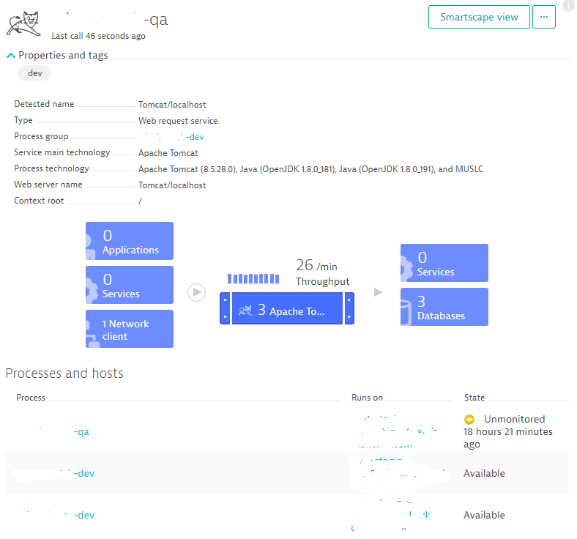
Properly Separating Entities
Tagged as Dev
Get Process Grouping right FIRST
Including uses Host Groups if needed
Services CANNOT span Process Groups
Service Merging will not work
Process Group Naming is not the same as Process Group Detection
Tagging rules will typically not fix incorrect Process Grouping
Process Group QA
QA and Dev mixed

Slide 55
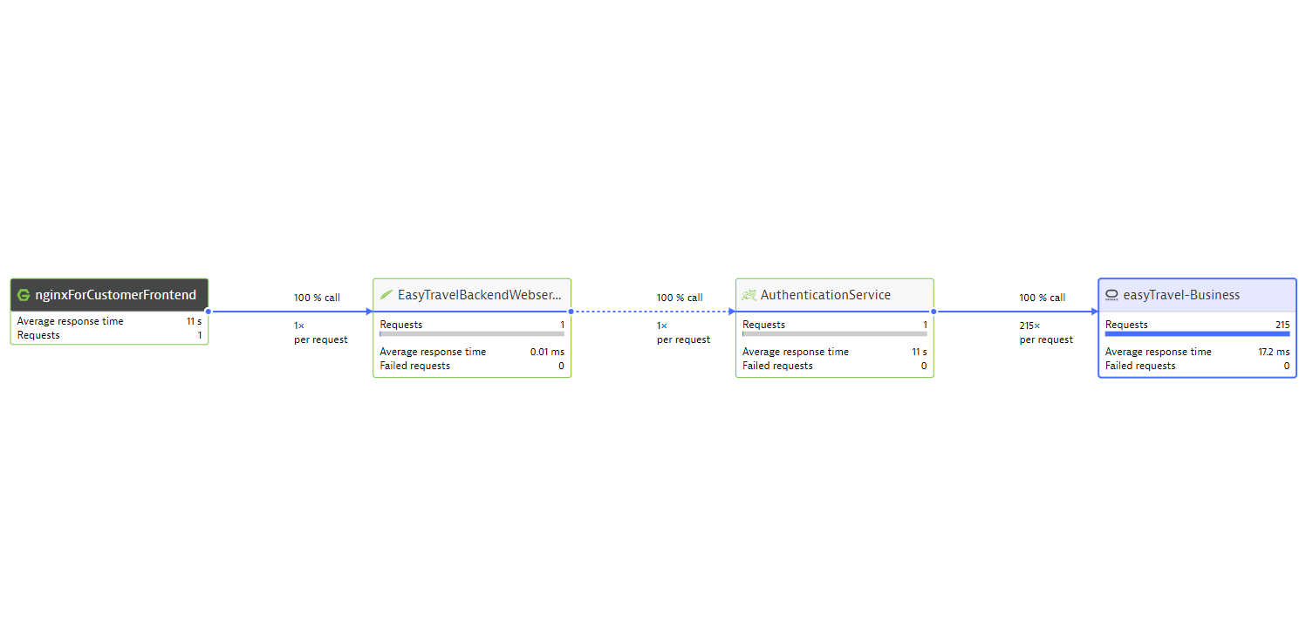
DB Spamming
Total Transaction took 11s, for a single request
Single request spawns 215 DB queries!

Slide 56
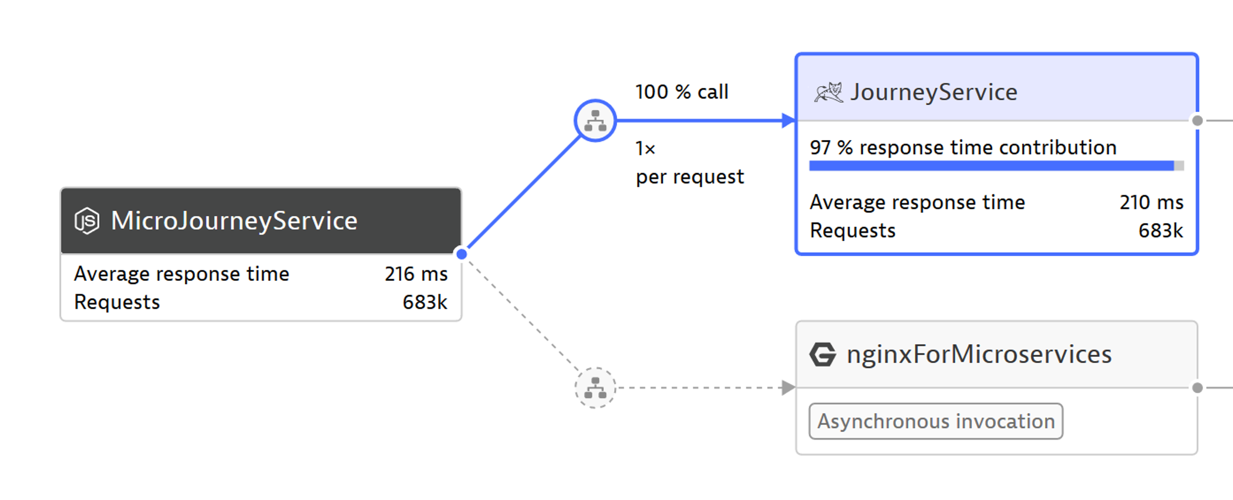
Microservices – Considerations for tightly coupled services

Slide 57
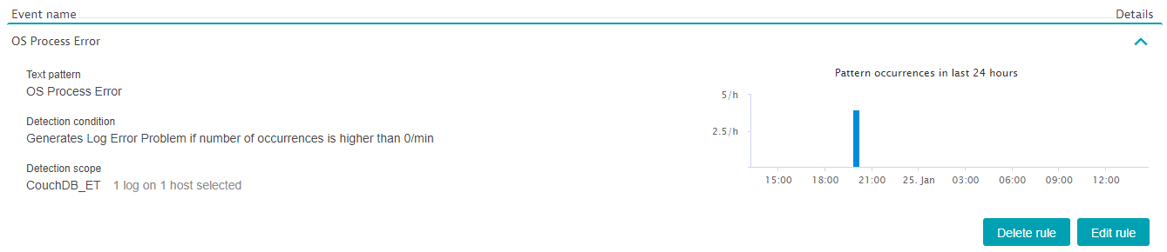
Don’t forget about the Logs
Using Log Event Detection can help find application errors
Common Use Cases:
Detect Application Errors in Native Processes
Detect Errors with the Application Infrastructure (syslog, Windows Event Logs, etc…)
Detect Errors in CloudTrail logs

Slide 58
Remember to Delete your AWS Resources!!!

Slide 59
Q & A

